Slide 1
Statistical Examination of Risk Factors in High Casualty Mass-Shootings
Arsham Vosoughinia
Data provided by Mass-Shooting Project Association
Funded National Institute of Justice

Slide 2
Data Introduction:
Data gathered by “The Mass-Shooting Project” Association
Dataset examines and quantizes various life-background factors of the perpetrator (History of Mental Illness, Race, Religion, History of Substance Abuse, etc.)
Dataset examines and quantizes the details of each incident (Location, Time, Number of Killed, etc.)

Slide 3
Goals of the Research:
Find the total number of victims for each incident ( Killed and Injured)
Identify the suggested risk factors of Age, Race, State/Location and History of Mental Illness for each incident
Find the strength of correlation between each factor and the number of victims
Examine whether there is likelihood in predicting the severity of incident with respect to each factor
Present recommendations for National Crime Prevention officials with the intention to minimize the number of victims arising from such matters

Slide 4
Factors examined:
Perpetrator’s Age | VS. | Incident’s total number of people killed or injured
Perpetrator’s Race
Perpetrator history of Mental Illnesses
Incident’s location/State

Slide 5
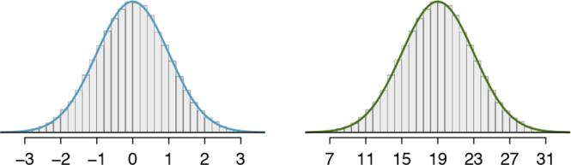
Visual examples of normally distributed data:
Figure for data distribution follows a bell-shaped Gaussian pattern
Gaussian pattern is relatively symmetrical around the mean

Slide 6
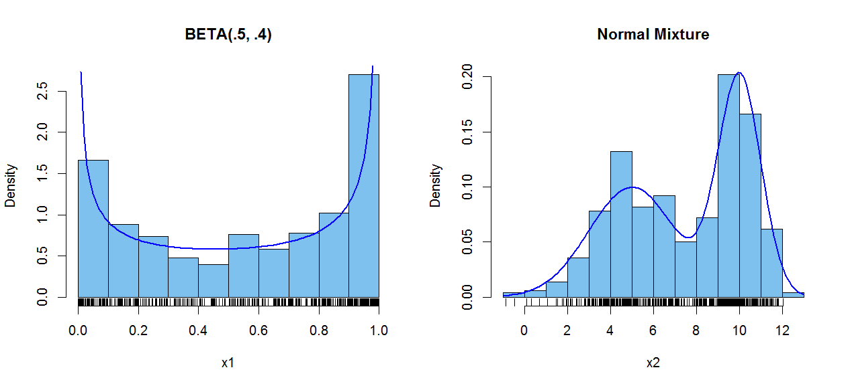
Visual examples of NOT normally distributed data:
Data Figure does not follow a typical bell-shaped Gaussian pattern

Slide 7
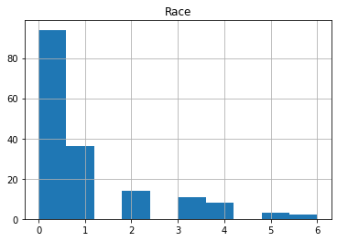
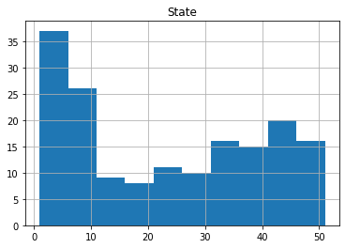
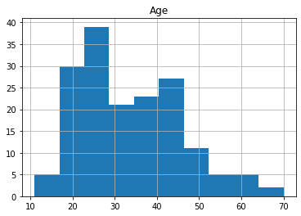
Mass-Shooting selected factors data Distributions & normality check:
Normality disputed according to the graph
Normality disputed according to the graph
Appears Normal distribution

Slide 8
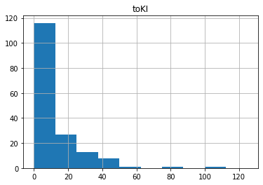
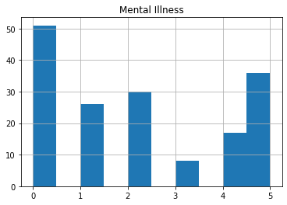
Mass-Shooting selected factors data Distributions & normality check:
Normality disputed according to the graph
Normality disputed via Shapiro-Wilk test
Normality disputed according to the graph

Slide 9
Statistical Test for prediction and codependence:
Method applied: Kruskal–Wallis Test
Reason for appliance: Most data are not normally distributed
Significant dependence likelihood between Age and Total Casualties
P-Value= 1.7 E-56 << 0.05
Significant dependence likelihood between Race and Total Casualties
P-Value= 1.3 E-34 << 0.05
Significant dependence likelihood between Location/State and Total Casualties
P-Value= 3.7 E-56 << 0.05
Significant dependence likelihood between Mental Illnesses and Total Casualties
P-Value= 3.0 E-43 << 0.05

Slide 10
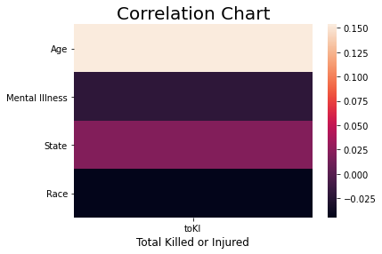
Strength of Correlation between factors:
Absolute value of correlation coefficient has a range of zero to 1
Higher value of correlation coefficient indicates stronger correlation

Slide 11
Recommendations:
Age, Race, Location/State and History of mental illnesses all proved to be strong factor in predicting the severity of an incident in terms of number of casualties, due to all the P-Values of Kruskal test were smaller than 5%.
The Age factor followed by Location/State showed a greater correlation to the number of casualties among all other factors.
No factor showed to be very strongly corelated to the number of casualties, with highest being the factor Age with correlation coefficient of of 0.15.
The outcome of this research can facilitate authorities and officials as well as social researchers in fight against the mass-shooting crisis in the U.S.

Slide 12
Questions?

Slide 13
THANK YOU

